Slide 1
Sprint 0 Delivery
Group 1 - Alex, Angel, Atanas, Stoyan, Tsanko

Slide 2
What did we do?
We had to analyze the given case from DAF Engine department.
We visited the company to examine their work methodology.
We did some research on the technologies DAF are using
Made draft project plan.
Learning outcomes could not be met
Came up with new idea
Presented it

Slide 3
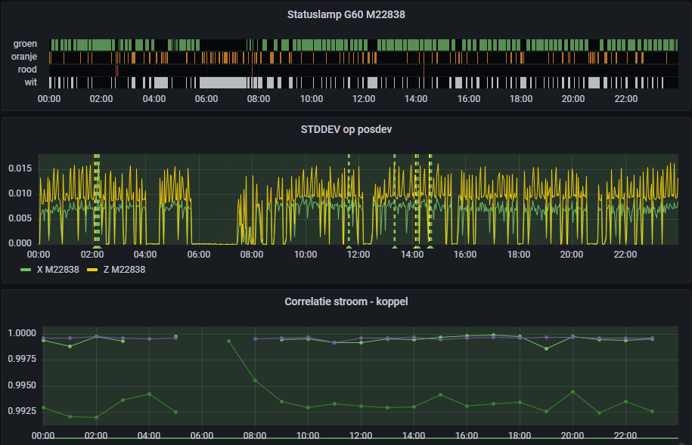



Meeting with DAF team to learn more about the assignment
Notes:
First week, tuesday immediately.
Talk with Jeffrey
Asked our questions
Whatever we could come up with
Technology choices
COmmon faults in machines
Concerns of current setup
Gave a virtual tour of the setup at DAF

Slide 4
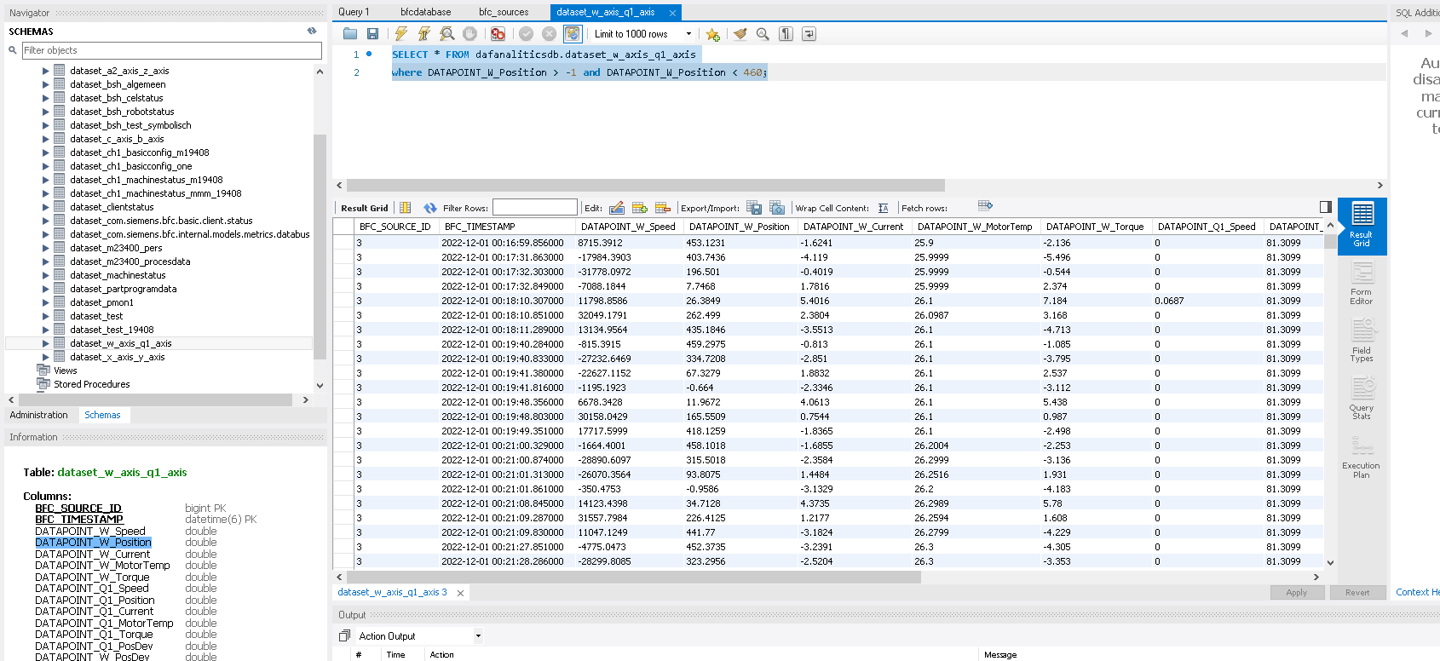
Received and analyzed raw data
Notes:
Sensors were grouped in pairs in a table
Lots of joins/compex queries to retrieve useful data

Slide 5
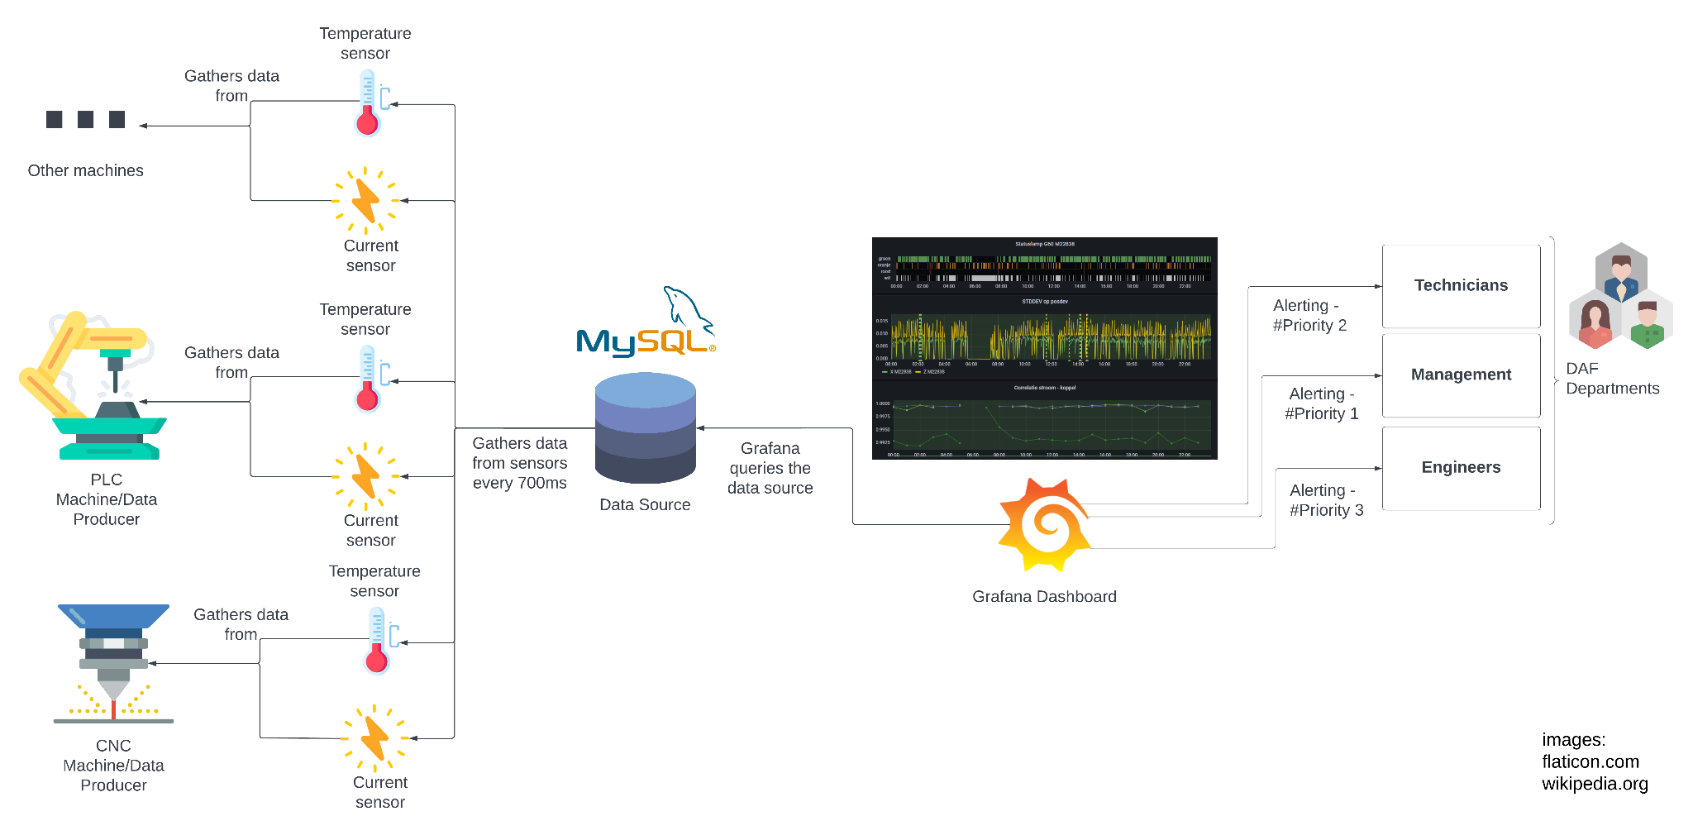
Our understanding of the current setup
Notes:
After visiting daf
Viewer needs to know sql to make things work, so a view into an alternative is a good idea
Main concern is running out of storage not much else
No cleaning of the data is expected from us

Slide 6
Wrote and submitted draft project plan
Learning outcomes could not be met
Scalable architecture
Development and operations(DevOps)
Security by design
Distributed data
Cloud services
Notes:
Wrote and submitted
However we realised we are a bit constrained at least on first sight

Slide 7
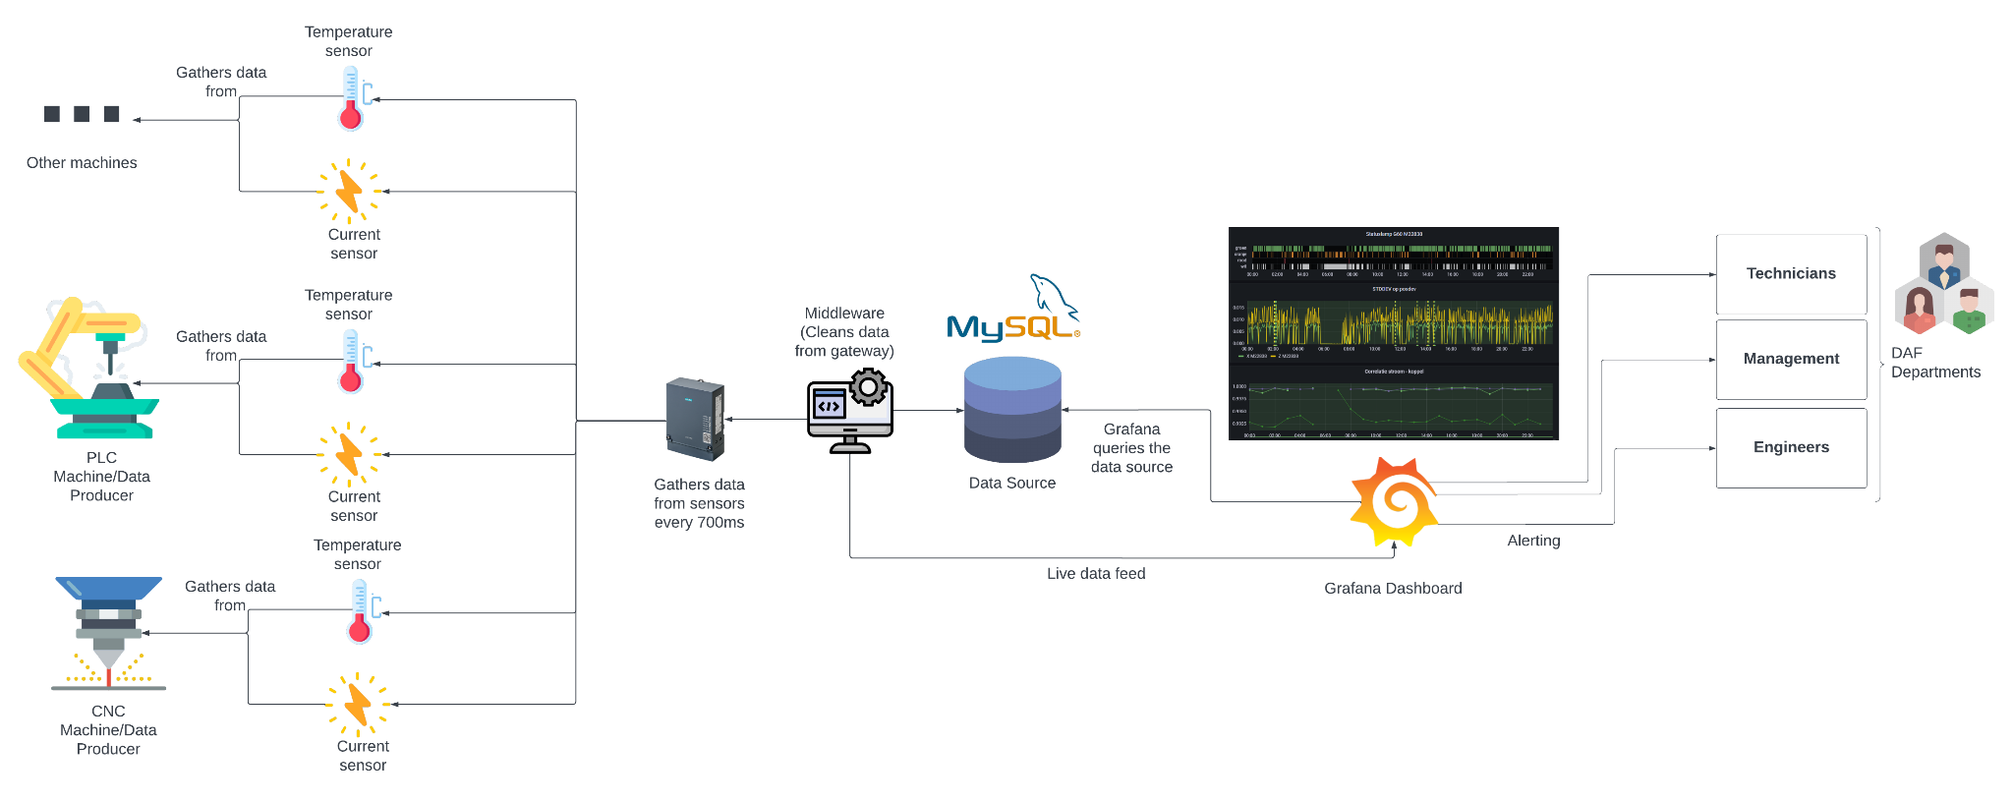
Proposed solution
Notes:
The idea mainly because we do not have access to the gateway to reformat the data
Also gives room to fulfil our learning outcomes
However, it was deemed as extra maintenance and rejected

Slide 8

Now what?
Notes:
Retrospective
sprint planning
get ideas from DAF to accomplish learning outcomes
Back on the whiteboard, agree on a solution
Start with basic lay out on the things that will not change in the project plan.

Slide 9
Thank you for your time

